Slide 1

APPLICATION SECURITY
(Threats and Malpractices)
Speaker: Dimitrios Valsamaras | @Ch0pin
https://www.linkedin.com/in/valsamaras/

Slide 2

Common Malpractices
Webviews
Floating Windows
Accessibility Service
Administration API
Reflection
Dynamic Code Loading

Slide 3
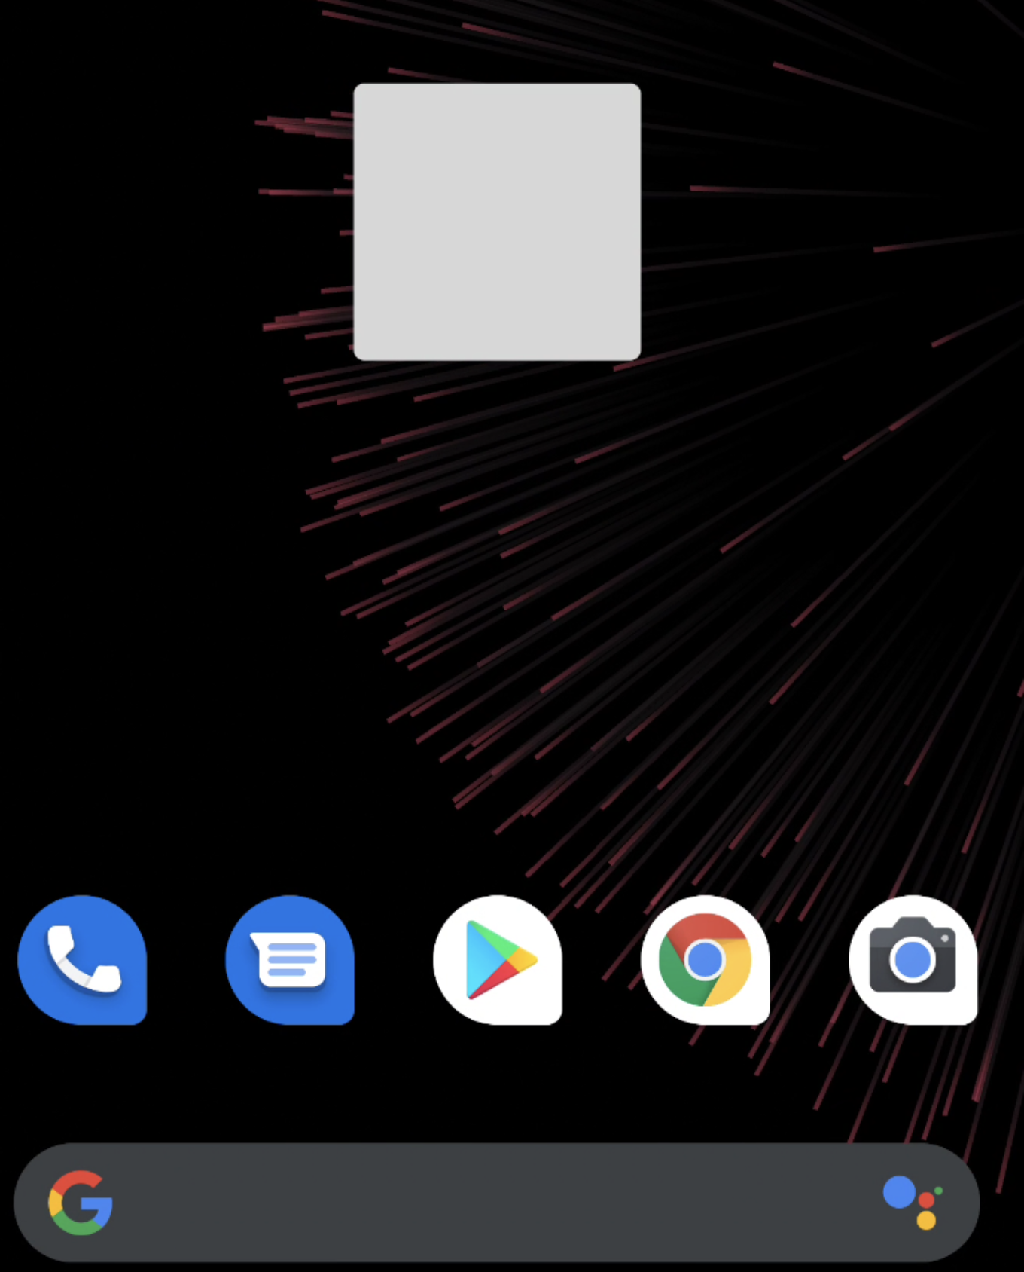
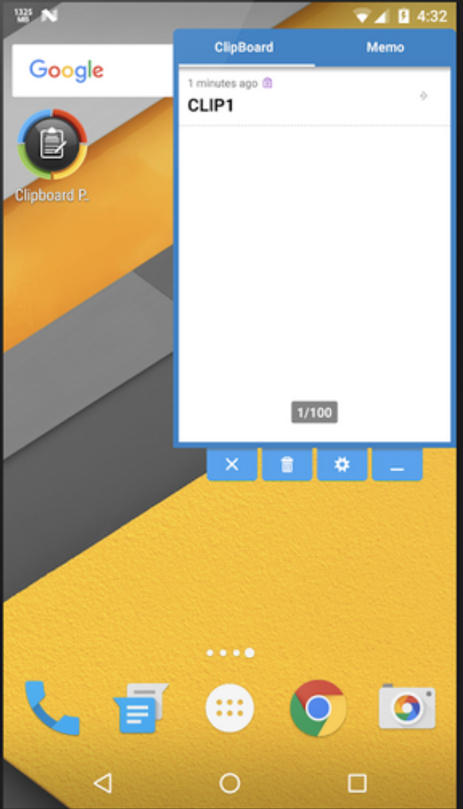
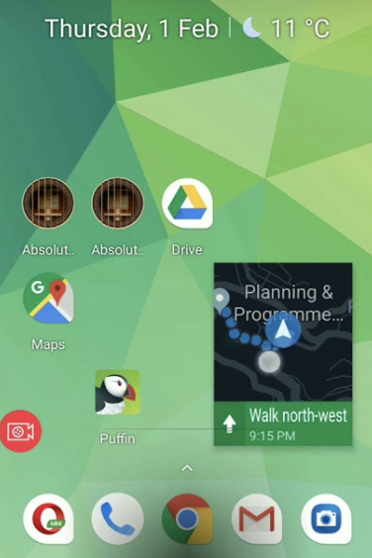
Free Floating Windows
Definition: A free floating window is a category of windows that can appear freely above any other applications while its existence doesn’t depend on its parent. Additionally, its behaviour and appearance is fully customisable and controllable by the developer.
Not to be confused with Picture in Picture (e.g. Google Maps, youtube e.t.c.)

Slide 4
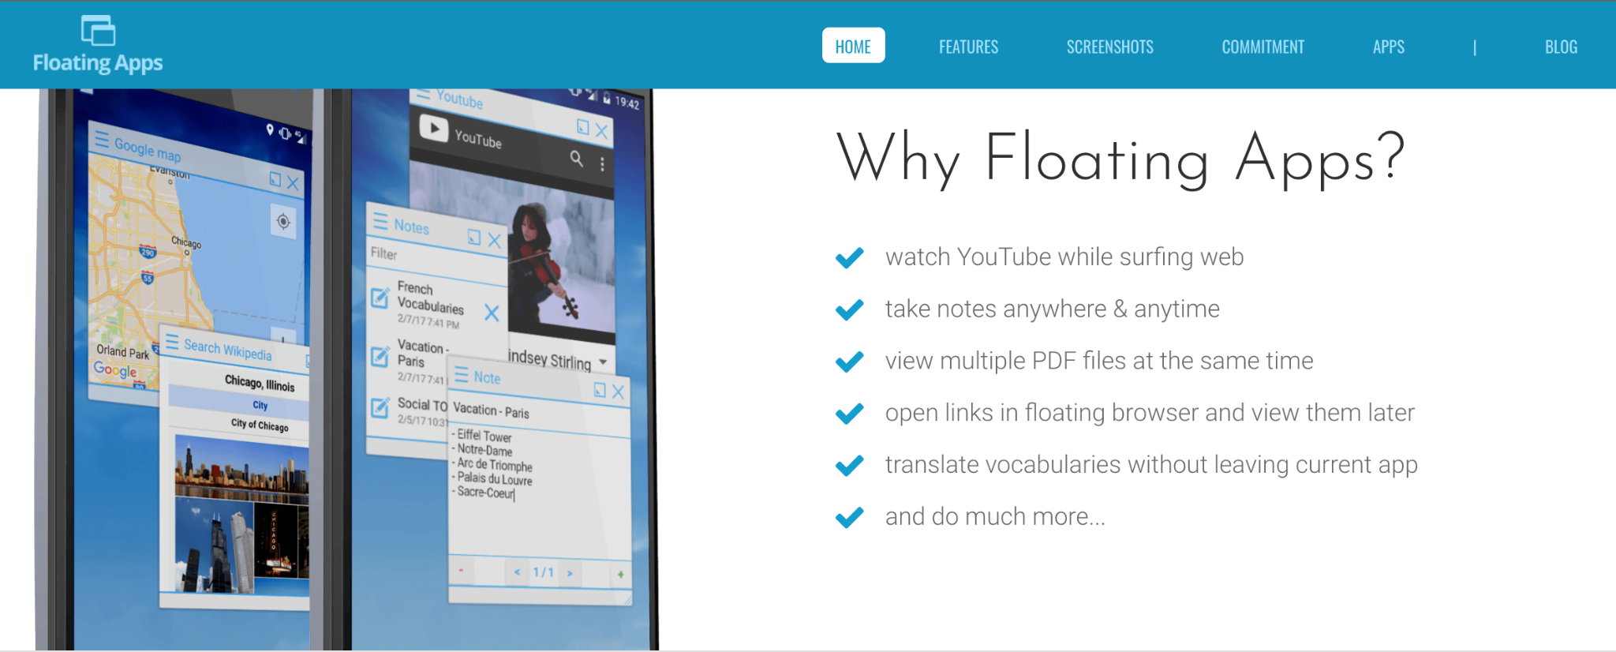
Free Floating Windows
Some Features
https://www.floatingapps.net/

Slide 5
FFW Implementation
By the time that SYSTEM_ALERT_WINDOW permission is approved, an application is authorised to create a TYPE_APPLICATION_OVERLAY window type which will be displayed on top of other activities, but below critical system ones (e.g. status bar or IME).
Besides a fully customizable appearance, a flag attribute will affect the event processing behaviour of a window, so a flag FLAG_NOT_TOUCHABLE will dispatch the events to the window behind, while a FLAG_WATCH_OUTSIDE_TOUCH will inform the app about the event but will omit details like the touch coordinates.

Slide 6
FFW Implementation (creating a floating button)
<uses-permission android:name="android.permission.SYSTEM_ALERT_WINDOW"/>
Create a view (e.g. a button)
Button floatingButton = new Button(getApplicationContext());
Create a Window Manager instance
WindowManager windowManager = (WindowManager) getSystemService(WINDOW_SERVICE);
Customize via the Layout Parameters
WindowManager.LayoutParams params = new WindowManager.LayoutParams(width, height,
WindowManager.LayoutParams.TYPE_APPLICATION_OVERLAY,
WindowManager.LayoutParams.FLAG_NOT_TOUCHABLE | WindowManager.LayoutParams.FLAG_NOT_FOCUSABLE,
PixelFormat.TRANSPARENT);

Slide 7

FFW Implementation (creating a floating button - continued )
Add the view to the FFW
windowManager.addView(floatingButton, params);
FFW

Slide 8
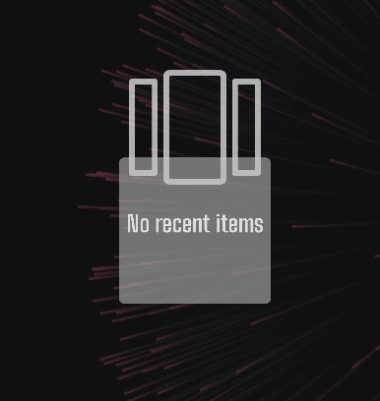
FFW Implementation (creating a floating button - continued )
Remove the Parent
<activity android:name=".MainActivity" android:autoRemoveFromRecents="true" android:noHistory="true">

Slide 9
FFW What is wrong with that ?
Background Restrictions (Android 8.0):
Apps that are running in the background now have limits on how freely they can access background services.
Apps cannot use their manifests to register for most implicit broadcasts (that is, broadcasts that are not targeted specifically at the app).
More restrictions ...
Android 10 (API level 29) and higher place restrictions on when apps can start activities when the app is running in the background. These restrictions help minimize interruptions for the user and keep the user more in control of what's shown on their screen.

Slide 10
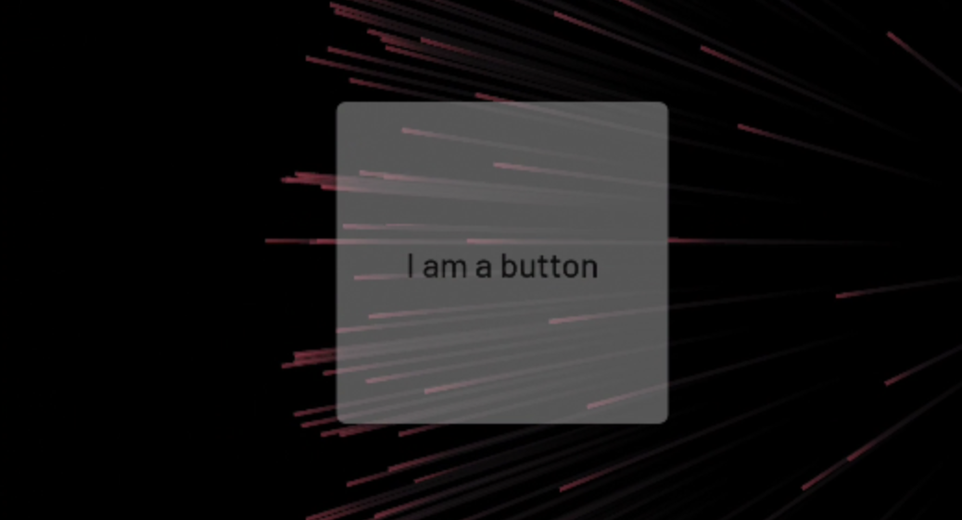


FFW What is wrong with that ?
Exceptions to the restriction
Apps running on Android 10 or higher can start activities only when one or more of the following conditions are met:
The app has a visible window, such as an activity in the foreground.
The app has an activity in the back stack of the foreground task.
The app has an activity in the back stack of an existing task on the Recents screen.
btn.setAlpha(0);
Can it be invisible ?

Slide 11
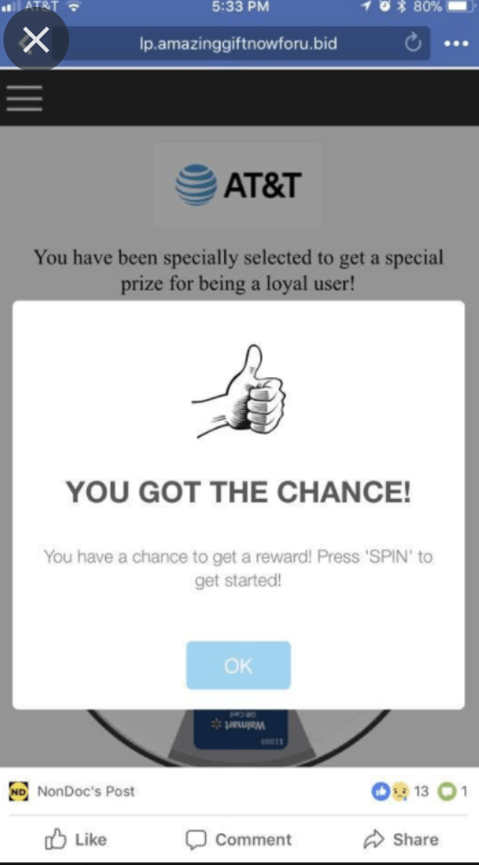
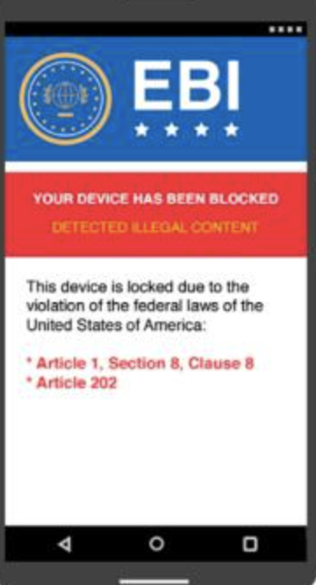
FFW Abuse
From Free Floating Windows to Free Popping Windows
SPAM
Ransomware

Slide 12
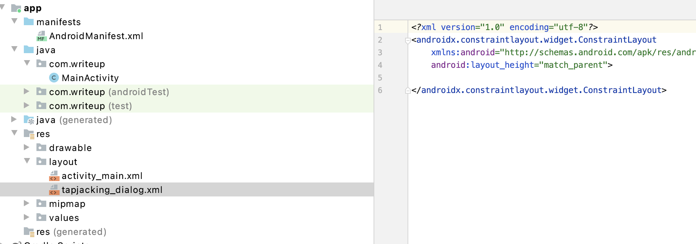
FFW Abuse, TapJacking
Creating more than a simple View...
A LayoutInflater instantiates a layout XML file into its corresponding View objects
LayoutInflater layoutInflater = getLayoutInflater();
View mLayout = layoutInflater.inflate(R.layout.tapjacking_dialog,null);
windowManager.addView(mLayout,params);

Slide 13
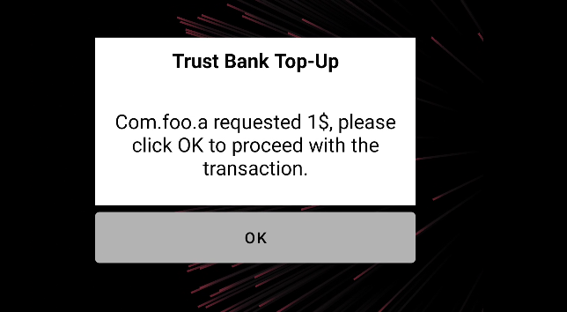
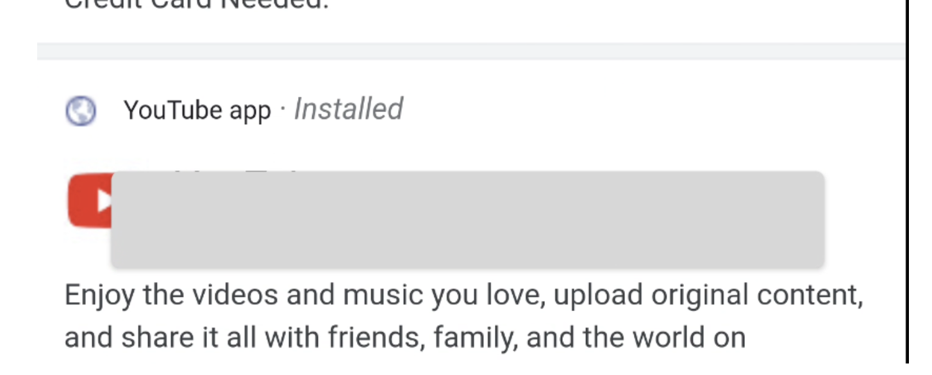
FFW Abuse, TapJacking
WindowManager windowManager = (WindowManager) getSystemService(WINDOW_SERVICE);
WindowManager.LayoutParams params = new WindowManager.LayoutParams(1200,1200,
WindowManager.LayoutParams.TYPE_APPLICATION_OVERLAY,
WindowManager.LayoutParams.FLAG_NOT_TOUCHABLE | WindowManager.LayoutParams.FLAG_NOT_FOCUSABLE,
PixelFormat.TRANSPARENT);
Click through:
Send touches to the window behind

Slide 14
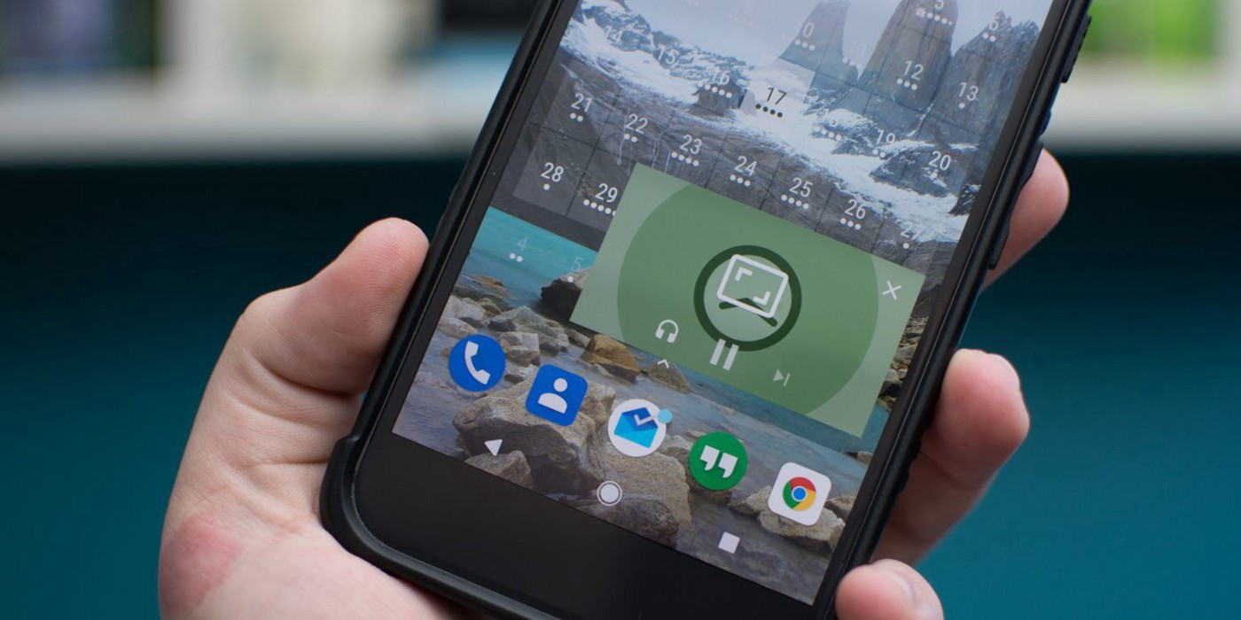
Picture In Picture
Definition: PiP is a special type of multi-window mode mostly used for video playback. It lets the user watch a video in a small window pinned to a corner of the screen while navigating between apps or browsing content on the main screen.
Popular Applications that use PiP:
YouTube
Google Maps
Facebook Messenger

Slide 15
Picture In Picture - Implementation
No special permissions !!
Add the specific entry in the AndroidManifest
<activity android:name="VideoActivity"
android:supportsPictureInPicture="true"
android:configChanges=
"screenSize|smallestScreenSize|screenLayout|orientation"
Call the enterPictureInPictureMode
public void onActionClicked(Action action) {
if (action.getId() == R.id.lb_control_picture_in_picture) {
getActivity().enterPictureInPictureMode();
return;
}
...
}

Slide 16
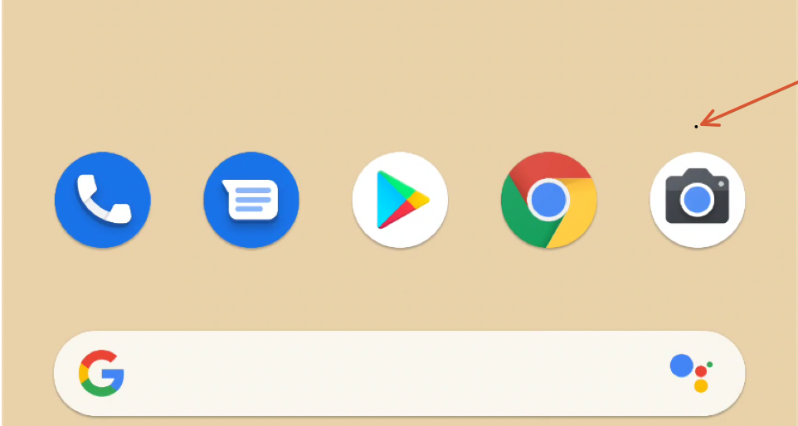
Picture In Picture
Applications in PiP mode maintain their foreground state
A PiP window is enclosed in a shadowed frame, which is a fact that renders it visible to the user even if the activity has been set up to be transparent.
No size restrictions though as it can be arbitrary small or large
<activity android:name=".MainActivity"
android:supportsPictureInPicture="true"
android:theme="@style/Theme.AppCompat">
<layout android:defaultHeight="1dp"
android:defaultWidth="1dp"
android:gravity="top|end"
android:minHeight="1dp"
android:minWidth="1dp" />

Slide 17
References
https://ink.library.smu.edu.sg/cgi/viewcontent.cgi?article=4724&context=sis_research
https://valsamaras.medium.com/tapjacking-attacks-a-thorough-guide-2cd6486d0fc9
https://developer.android.com/guide/topics/ui/picture-in-picture#:~:text=PiP%20is%20a%20special%20type,content%20on%20the%20main%20screen
https://www.tutorialspoint.com/android/android_user_interface_layouts.htm
https://www.zdnet.com/article/this-new-malware-uses-remote-overlay-attacks-to-hijack-your-bank-account/

